Slide 1
CE80362 : Circuit Analysis
Lecture 3:
Network Theorems.

Slide 2
Superposition Theorem
The superposition theorem is a method that allows us to determine the current through or the voltage across any resistor or branch in a network.
The advantage of using this approach instead of mesh analysis or nodal analysis is that it is not necessary to use determinants or matrix algebra to analyze a given circuit.
The theorem states the following:
    “The total current through or voltage across a resistor or branch may be determined by summing the effects due to each independent source”.

Slide 3

In order to apply the superposition theorem it is necessary to:
    remove all sources other than the one being examined.
This is done by zeroing sources in the circuit (only sources which are not considered)
    Replace a Voltage source with a short circuit, since the voltage across a short circuit is zero volts.
    Replace a current source with an open circuit, since the current through an open circuit is zero amps.
The power dissipated by any resistor can be found by:

Slide 4
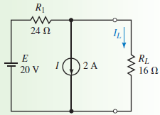
Determine the Current through any given elements.
Example (1):
Determine the current in the load resistor, RL of the circuit below. Verify that the superposition theorem does not apply to power.
Solution:
(a) Consider Only the voltage Source:
We first determine the current through RL due to the voltage source by removing the current source and replacing in with an open circuit (zero amps)

Slide 5
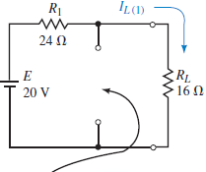

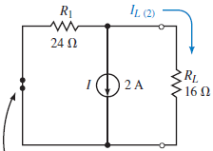

The resulting current through R_{L} is determined from Ohm’s law as:
Current source replaced with an open circuit
(b) Consider the Current Source
We determine the current through RL due to the current source by removing the voltage source and replacing it with a short circuit (zero volts)
By CDR, the resulting
current through RL is:
Voltage source replaced with a short circuit

Slide 6
The resultant current through RL is found by applying the superposition theorem:
I_{L}=0.5 A +(- 1.2 A)= - 0.700 A
The negative sign indicates that the current through RL is opposite to the assumed reference direction.
Consequently, the current through RL will be upward with a magnitude of 0.7 A.

Slide 7
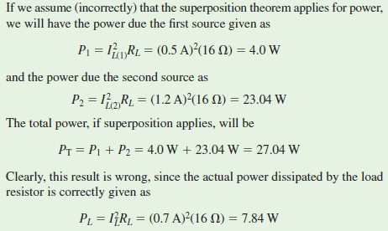

Slide 8
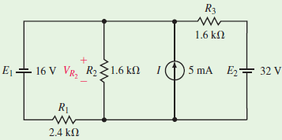
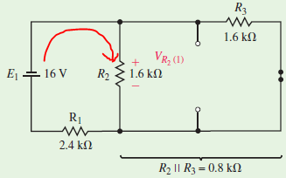
Determine the voltage across any component.
Example (2): Apply superposition theorem to determine the voltage drop across the resistor R₂ of the circuit.
Solution:
We consider every Source individually, while others are zeroed.
(a) If ONLY E1 is Considered:
Since R₂||R₃= 0.8kΩ

Slide 9

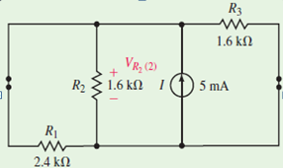

By VDR, the voltage across R₂ will be the same as the voltage across the parallel combination.
The negative sign in the preceding calculation simply indicates that the voltage across the resistor due to the first source is opposite to the assumed reference polarity.
(b) Consider the current source I.
The total resistance “seen” by the current source is:
By applying ohm’s law
Both have the same voltage as they are all in parallel

Slide 10
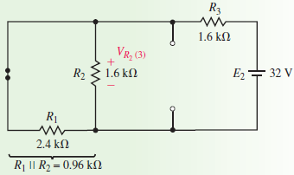
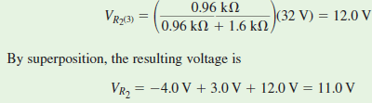
(c) Consider the voltage Source E2 due to the 32 V.
Then, the voltage across R2, is given by VDR as:

Slide 11
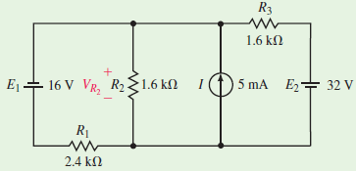
Example for Enhancement
Use the superposition theorem to determine the voltage across R₁ and R₃ in the following circuit.

Slide 12
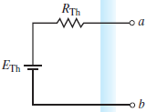
Thévenin’s Theorem
Thévenin’s theorem allows even the most complicated circuit to be reduced to a single voltage source and a single resistance.
Thévenin’s theorem is a circuit analysis technique that reduces any linear bilateral network to an equivalent circuit having only one voltage source and one series resistor.
The resulting two-terminal circuit is equivalent to the original circuit when connected to any external branch or component (Load).
In summary, Thévenin’s theorem is simplified as follows:
    “Any linear bilateral network may be reduced to a simplified two-terminal circuit consisting of a single voltage source in series with a single resistor”.
Reduced Circuit to a single voltage source and a single series resistance

Slide 13
Steps to converts any circuit into its Thévenin equ. ckt
Identify and remove the load from the circuit.
Label the resulting two terminals (as a and b).
Set all sources in the circuit to zero: Voltage sources are set to zero by replacing them with short circuits, Current sources are set to zero by replacing them with open circuits.
Determine the Thévenin equivalent resistance, R_{Th}, by calculating the resistance “seen” between terminals a and b. Redraw the circuit.
Replace the sources removed in Step 3, and determine the open-circuit voltage between the terminals. If the circuit has more than one source, it may be necessary to use the superposition theorem. In that case, it will be necessary to determine the open-circuit voltage due to each source separately and then determine the combined effect. The resulting open-circuit voltage will be the value of the Thévenin voltage, E_{Th}.
Draw the Thévenin equivalent circuit using R_{Th} and E_{th} and include that portion of the network removed in Step 1.

Slide 14
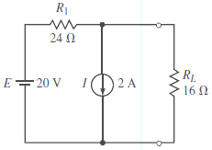
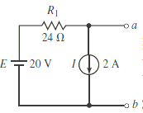
Example (1):
Determine the Thévenin equivalent circuit external to the resistor R_{L} for the circuit. Use the Thévenin equivalent circuit to calculate the current through R_{L}.
Solution:
Steps 1 and 2: Removing the load resistor from the circuit and labelling the remaining terminals,

Slide 15
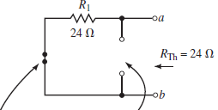
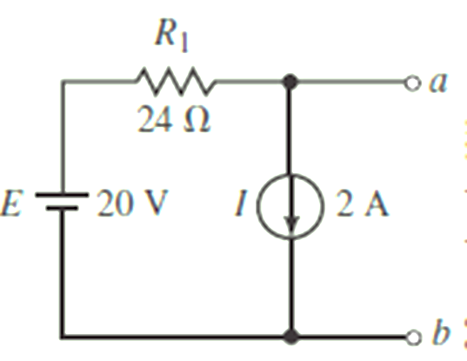

Step 3: Setting the sources to zero
Voltage source replaced
with a short circuit
Current source replaced with an open circuit
Step 4: The Thévenin resistance between the terminals is R_{TH} =24 Ω.
Step 5: From the figure on the right, the open-circuit voltage between terminals a and b is:

Slide 16
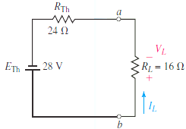

Step 6: The resulting Thévenin equivalent circuit is:
Hence, Using this Thévenin equivalent circuit, we easily find the current through R_{L} as:

Slide 17
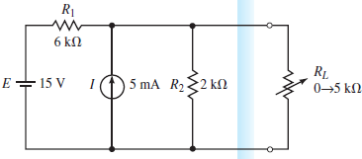
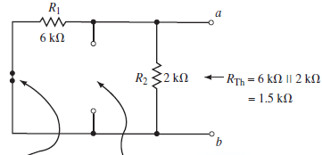
Example (2)
Find the Thévenin equivalent circuit of the given circuit. Using the equivalent circuit, determine the current through the load resistor when R_{L}=0Ω, R_{L}=2 kΩ and R_{L}=5 kΩ.
Solution
Steps 1, 2, and 3: After removing the load, labelling the terminals, and setting
the sources to zero, we have:
Voltage source replaced with a short circuit
Current source replaced with an open circuit
Step 4: The Thévenin resistance of the circuit is
Rth= 6kΩ|| 2kΩ=1.5kΩ

Slide 18
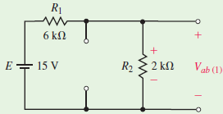

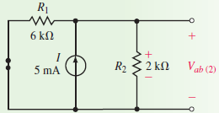

Step 5: Although several methods are possible, we will use the superposition theorem to find the open-circuit voltage V_{ab} due to the contribution of the 15-V source
( apply VDR).
Apply superposition theorem to find the open-circuit voltage V_{ab} for determining the contribution due to the 5-mA source (apply ohm’s law).

Slide 19

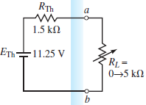
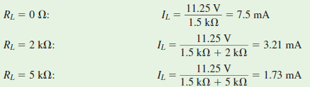
Hence,
Step 6: The resulting Thévenin equivalent circuit is:
From the left circuit, it is now an easy matter to determine the current for any value of load resistor as follows (Apply ohm’s law):

Slide 20
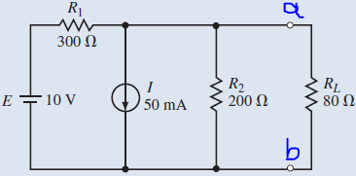
(2) Use Thévenin’s theorem to determine the current through load resistor R_{L} for the
Circuit of Fig below
Notes:
Answer” I_{L} =10.0 mA (upward)

Slide 21
Norton’s Theorem
Norton’s theorem is a circuit analysis technique that is similar to Thévenin’s theorem.
By using this theorem, we reduce the circuit to a single current source and one parallel resistor.
As with the Thévenin equivalent circuit, the resulting two-terminal circuit is equivalent to the original circuit when connected to any external branch or component.
In summary, Norton’s theorem may be simplified as follows:
    “Any linear bilateral network may be reduced to a simplified two-terminal circuit consisting of a single current source and a single shunt resistor”.

Slide 22
Steps to convert any circuit into its Norton equivalent:
Identify and remove the load from the circuit
Label the resulting two terminals (as a and b).
Set all sources to zero. As before, voltage sources are replaced by short circuits, and current sources by open circuits.
Determine the Norton equivalent resistance, R_{N}, by calculating the resistance seen between terminals a and b. Redraw the circuit.
Replace the sources removed in Step 3, and determine the current that would occur in a short if the short were connected between terminals a and b. If the original circuit has more than one source, it may be necessary to use the superposition theorem. The resulting short-circuit current will be the value of the Norton current I_{N}.
Sketch the Norton equivalent circuit using the resistance R_{N} and I_{N.} Then, include that portion of the network removed in Step 1 (load).

Slide 23
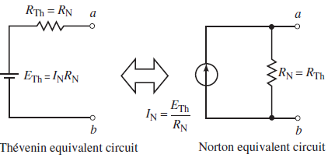

Also , the Norton equivalent circuit may also be determined directly from the Thévenin equivalent circuit by using the source conversion technique (Source transformation)
From the left Circuit, We can calculate the following:

Slide 24
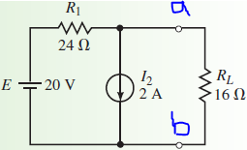
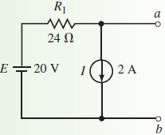
Example (1):
Determine the Norton equivalent circuit external to the resistor R_{L} for the given circuit. Use the Norton equivalent circuit to calculate the current through R_{L}. Compare the results to those obtained using Thévenin’s theorem.
Solution:
Steps 1 and 2: Remove load resistor R_{L} from the circuit and label the remaining terminals as a and b.

Slide 25
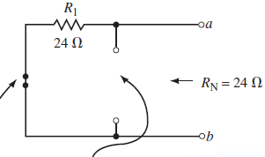
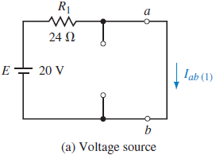
Step 3: Zero the voltage and current sources as shown in the circuit on the right.
Voltage source replaced with a short circuit
Current source replaced with an open circuit
Step 4: The resulting Norton resistance between the terminals is R_{N}=R_{ab}= 24 Ω
Step 5: The short-circuit current is determined by first calculating the current through the short due to each source.

Slide 26

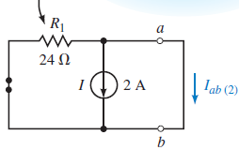
Voltage Source, E: The current in the short between terminals a and b
Current Source, I: By examining the circuit for the current source, we see that the short circuit between terminals a and b effectively removes R₁ from the circuit.
Therefore, the current through the short will be I_{ab(2)}= -2.00 A
R₁ is shorted by the short circuit between a and b
Notice that R₁ is shorted by the short circuit between a and b
(b) The current source

Slide 27
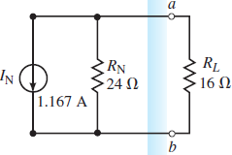

Now, applying the superposition theorem, we find the Norton current as:
I_{N} = I_{ab(1)}+I_{ab(2)} = 0.833 A - 2.0A= - 1.167 A
As before, the negative sign indicates that the short-circuit current is actually from terminal b toward terminal a.
Step 6: The resultant Norton equivalent circuit is shown.
Now we can easily find the current through load resistor R_{L} by using the current divider rule:

Slide 28
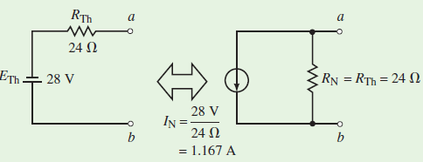
We see that the same result was obtained by using the Thévenin equivalent circuit (See Source transformation).

Slide 29
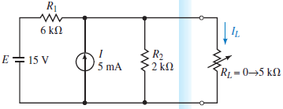
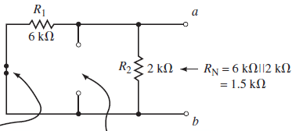
Example (2):
Find the Norton equivalent of the circuit external to resistor R_{L} in the circuit. Use the equivalent circuit to determine the load current I_{L} when R_{L}=0, 2 kΩ, and 5 kΩ.
Solution
Steps 1, 2, and 3: After removing the load resistor, labelling the remaining two terminals a and b, and setting the sources to zero, we have the following circuit
Voltage source replaced with a short circuit
Current source replaced with an open circuit

Slide 30
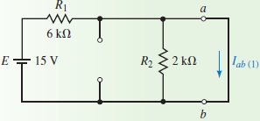

Step 4: The Norton resistance of the circuit is found as R_{N}=6 kΩ||2 kΩ =1.5 kΩ.
Step 5: The value of the Norton constant-current source is found by determining the current effects due to each independent source acting on a short circuit between terminals a and b.
Voltage Source, E: A short circuit between terminals a and b eliminates resistor R₂ from the circuit. The short-circuit current due to the voltage source is:

Slide 31
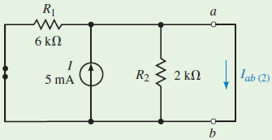
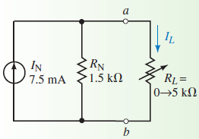
Current Source, I: The short circuit between terminals a and b eliminates both resistors R₁ and R₂. The short-circuit current due to the current source is therefore:
I_{ab(2)}=5.00 mA
The resultant I_{N} is found from superposition as:
I_{N} =I_{ab(1)} +I_{ab(2)} =2.50 mA +5.00 mA =7.50 mA
Step 6: The Norton equivalent circuit is:

Slide 32
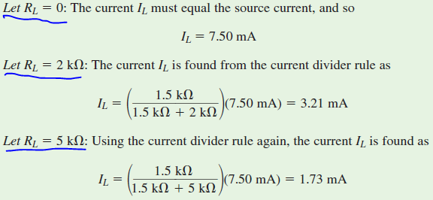
Using CDR, we have:

Slide 33
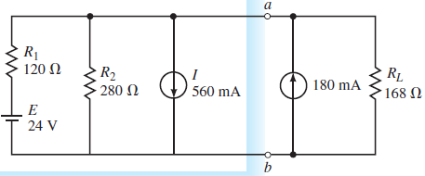
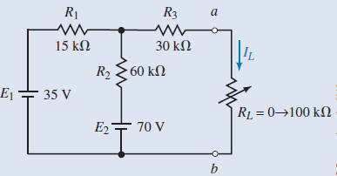
Example for Enhancement:
Find the Norton equivalent circuit external to terminals a and b. Determine the current through R_{L}.
2. Find the Norton equivalent external to R_{L} in the circuit on the left. Solve for the current I_{L} when R_{L}=0, 10 kΩ, 50 kΩ, and 100 kΩ.

Slide 34
Maximum Power Transfer Theorem
In amplifiers and in most communication circuits such as radio receivers and transmitters, it is often desired that the load receive the maximum amount of power from a source.
The maximum power transfer theorem states the following:
      “A load resistance will receive maximum power from a circuit when the resistance of the load is exactly the same as the Thévenin (Norton) resistance looking back at the circuit”.
The maximum power will occur when R_{L}=R_{Th}=R_{N}

Slide 35
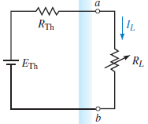
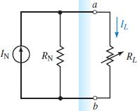
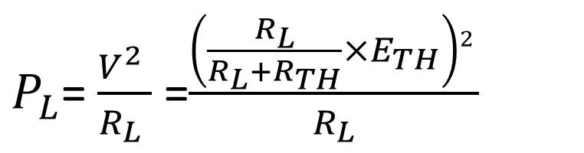
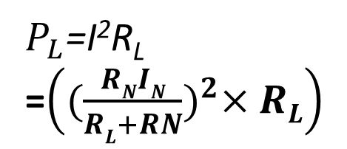
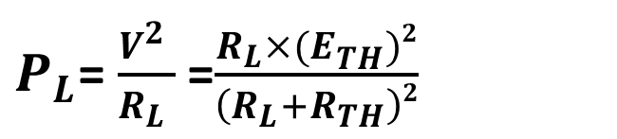
By examining the Thevenin’s equivalent circuits and by using VDR, the power delivered to the load is given by:
V drop across RL (use VDR)
$P_{L}$= $\frac{V^{2} }{R_{L} }$=$\frac{\left(\frac{R_{L}}{R_{L}+R_{TH}}×E_{TH}\right)2 }{R_{L}}$
$P_{L}$= $\frac{V^{2} }{R_{L} }$=$\frac{R_{L}×(E_{TH}^{})2}{\left(R_{L}+R_{TH}\right)2}$
Then By Considering The Norton’s Theorem, and by applying CDR, the Power delivered to the load is Given by :
$P_{L}$=I²R_{L}
=$\left({(\frac{RNIN}{RL+RN})}^{2}×RL\right)$

Slide 36


Under maximum power conditions (R_{L}=R_{Th} =R_{N}), the preceding equations may be used to determine the maximum power delivered to the load as:
By Thevenin’s Theorem
By Norton’s Theorem
Example: Consider the Circuit of:
a. Determine the value of load resistance required to ensure that maximum
power is transferred to the load.
b. Find V_{L}, I_{L} , and P_{L} when maximum power is delivered to the load.

Slide 37
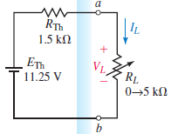
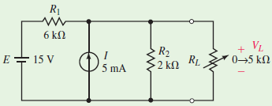
Example (1): Consider the following Circuit:
Determine the value of load resistance required to ensure that maximum power is transferred to the load.
Find V_{L}, I_{L}, and P_{L} when maximum power is delivered to the load.
The equivalent circuit external to the load.
Refer to slide 17-19

Slide 38

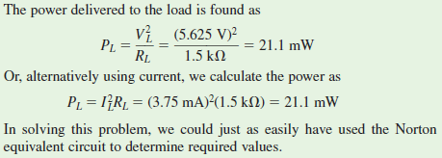
(a) Maximum power will be transferred to the load when R_{TH}=R_{L}=1.5 kΩ.
(b) At maximum power and by letting R_{L}=1.5 kΩ, the voltage across the Load (V_{L})is divided by 2, i.e, ½V_{L} is dissipated in R_{L} & another 1/2V_{L} is dissipated in R_{TH}

Slide 39


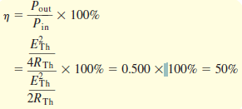
Efficiency
The efficiency (η) is defined as the ratio of output power to input power:
or
:As percentages
By using the maximum power transfer theorem, we see that under the condition of maximum power the efficiency (η) of the circuit is:
Note: R_{TH}=R_{L}, so in the Equi. ckt: R_{TH}+R_{TH}=2R_{TH}

Slide 40
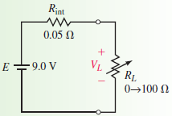


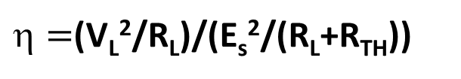
Example (2): For the following the circuit:
Determine the value of R_{L} needed for maximum power transfer.
Determine terminal voltage V_{L} and the efficiency when the value of the load resistor is R_{L}=50Ω.
Determine terminal voltage V_{L} and the efficiency when the value of the load resistor is R_{L}=100Ω.
$=$(V_{L}²/R_{L})/(E_{s}²/(R_{L}+R_{TH}))

Slide 41



c. For R_{L}=100Ω, the voltage appearing across the output terminals of the voltage source is
Notes:
To have a high efficiency, the load resistance should be much larger than the resistance of the source (typically R_{L}≥10R_{int}).
To ensure maximum power transfer, then the load resistance should equal the source resistance (R_{L}=R_{int}).

Slide 42

Example for Enhancement:
(1) Refer to the circuit on the right side.
  For what value of R_{L} will the load receive maximum power?
  Determine the power when R_{L}=R_{N}, when R_{L}=25 kΩ, and when R_{L}=50 kΩ.
(2) A Thévenin equivalent circuit consists of E_{Th}=10 V and R_{Th}=2kΩ.
Determine the efficiency of the circuit when
a. R_{L}=R_{Th}
b. R_{L}=0.5R_{Th}
c. R_{L}=2R_{Th}

Slide 43
Millman’s Theorem
Millman’s theorem is used to simplify circuits having several parallel voltage sources .
Although any of the other theorems developed in this chapter will work in this case, Millman’s theorem provides a much simpler and more direct equivalent.
The voltage sources may be replaced with a single equivalent source (Series of E_{eq}, R_{eq} and R_{L}).
To find the values of the equivalent voltage source E_{eq} and series resistance R_{eq}, we need to convert each of the voltage sources into their equivalent current sources.
The value of each current source would be determined by using Ohm’s law (i.e., I₁=E₁/R₁, I₂=E₂/R₂, etc.)

Slide 44



Circuits having several parallel voltage sources
Single equivalent source (Series of E_{eq}, R_{eq} and R_{L})
Converted voltage sources into their equivalent current sources

Slide 45



It is now possible to replace the n current sources with a single current source having a magnitude given as:
Write it as:
After Converting & Summing up currents, the E_{eq} is written as follows:

Slide 46


The general expression for the equivalent voltage is:
Example:
Use Millman’s theorem to simplify the circuit so that it has only a single source.
Use the simplified circuit to find the current in the load resistor, R_{L}.

Slide 47




Solution: We express the equivalent voltage source as:
The equivalent resistance is
Current through the load resistor:
Equivalent circuit

Slide 48
Reciprocity Theorem
The reciprocity theorem is a theorem that can only be used with single-source circuits. This theorem, however, may be applied to either voltage sources or current sources. The theorem states the following:
Voltage Sources:
    A voltage source causing a current I in any branch of a circuit may be removed from the original location and placed into that branch having the current I. The voltage source in the new location will produce a current in the original source location that is exactly equal to the originally calculated current, I.
When applying the reciprocity theorem for a voltage source, the following steps must be followed:
  The voltage source is replaced by a short circuit in the original location.
  The polarity of the source in the new location is such that the current direction in that branch remains unchanged.

Slide 49
Current Sources:
    “A current source causing a voltage V at any node of a circuit may be removed from the original location and connected to that node. The current source in the new location will produce a voltage in the original source location that is exactly equal to the originally calculated voltage, V”.
When applying the reciprocity theorem for a current source, the following conditions must be met:
  The current source is replaced by an open circuit in the original location.
  The direction of the source in the new location is such that the polarity of the voltage at the node to which the current source is now connected remains unchanged.

Slide 50


Example (1):
Consider the following circuit:
Calculate the current I.
Remove voltage source E and place it into the branch with R₃. Show that the current through the branch which formerly had E is now the same as the current I.

Slide 51


Polarity of the source is such that the current direction remains unchanged.
Now removing the voltage source from its original location and moving it into the branch containing the current I, we obtain the circuit:
When E is removed it is replaced by a short circuit.
We determine the current I as follows:
We see that the reciprocity theorem does indeed apply!!!

Slide 52


Example (2):
Consider the circuit shown.
Determine the voltage V across resistor R₃.
Remove the current source I and place it between node b and the reference node. Show that the voltage across the former location of the current source (node a) is now the same as the voltage V.

Slide 53


b. After relocating the current source from the original location, and connecting it between node b and ground, we obtain the circuit shown:
From the preceding results, we conclude that the reciprocity theorem again applies for the given circuit !!!

Slide 54




Tutorials for enhancement:
(1) Use Millman’s theorem to find the current through and the power dissipated by R_{L} in the following circuits (Fig. a, b, c & d)
Fig. (a)
Fig. (b)
Fig. (c)
Fig. (d)

Slide 55




(2) –(a). Apply reciprocity theorem to determine the current I (Fig. a & b) and the Voltage V (Fig. c & d) in the given circuits. (b) Show that reciprocity applies for the given circuit.
Fig. a
Fig. b
Fig. c
Fig. d

Slide 56
QUIZ
Use Thévenin’s theorem to determine the current through load resistor R_{L} for the following Circuit/5.
Consider the Maximum Power transfer theorem and Calculate the Power that is supposed to be transferred to the load.
What is the efficiency (η) at Maximum power?
What is the efficiency (η) if the load is 100Ω?

Slide 57
Assignment 1/10
By giving examples, do a detailed research and discuss the tellegen's theorem used in circuit network analysis

